Slide 1

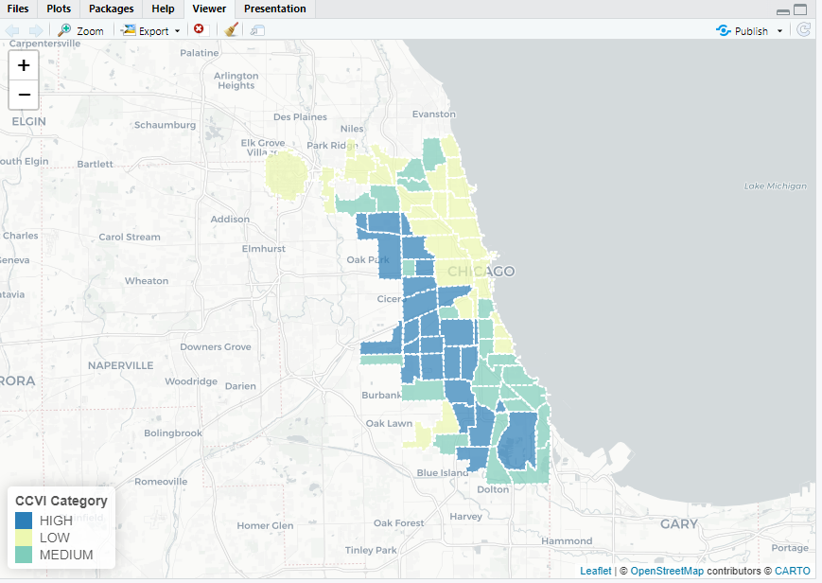
In the space below to copy/paste/insert a custom version (new color palette) of Figure 1 (map of CCVI Scores by Community Area) from the exercise.
GEO 3330 Sustainable Urban Transportation
Exercise #2: L Station Ridership Trends
Describe here any patterns you see in the map. Use data from the map to describe characteristics of at least one community located within each of the three CCVI categories.
Notably, southwestern communities are the highest risk of all areas. The affluent northside has the least risk.

Slide 2
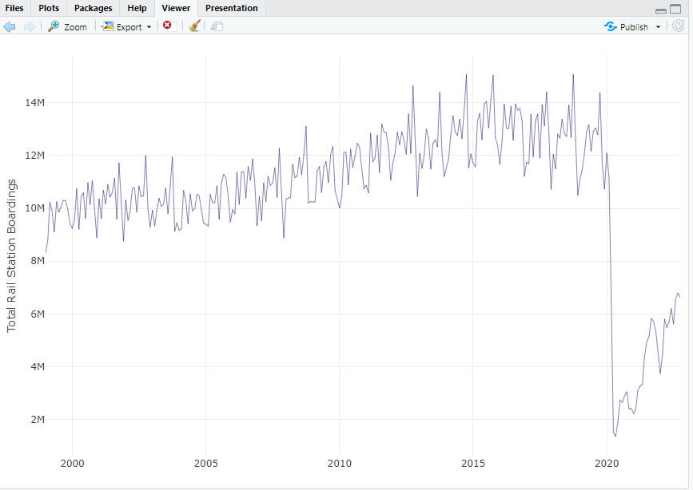
In the space below to copy/paste/insert Figure 2 or 3 from the exercise.
GEO 3330 Sustainable Urban Transportation
Exercise #2: L Station Ridership Trends
Describe patterns in rail boardings between 1999 and 2022. What do you think explains some of the cyclical variations in the data? What other factors may explain ridership over this period? Draw from the daily ridership plot to characterize ridership trends during the pandemic.
Outside of the massive pandemic drop, I think I notice a seasonal pattern, with more use during warmer months? Outside of this ridership slowly rose overtime.

Slide 3
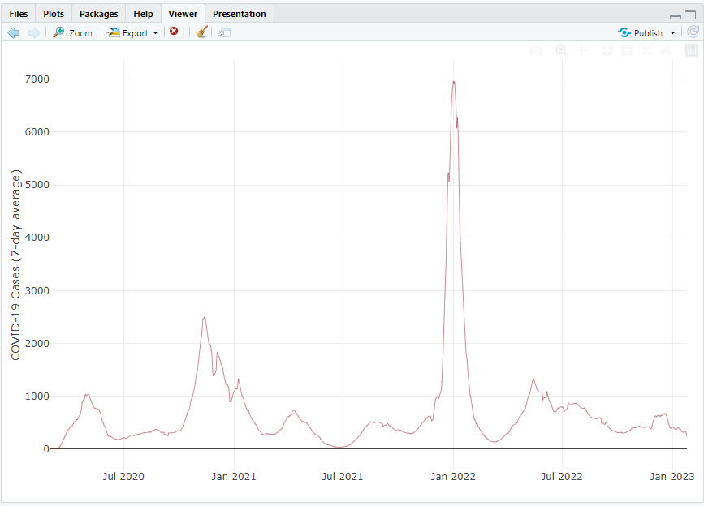
In the space below to copy/paste/insert Figure 4 from the exercise.
GEO 3330 Sustainable Urban Transportation
Exercise #2: L Station Ridership Trends
Are the waves and phases of the pandemic evident? Compare these pandemic phases to ridership trends over the same period. Do they appear to be related?
They seem to be related, with a spike happening during each peak ridership phase.

Slide 4
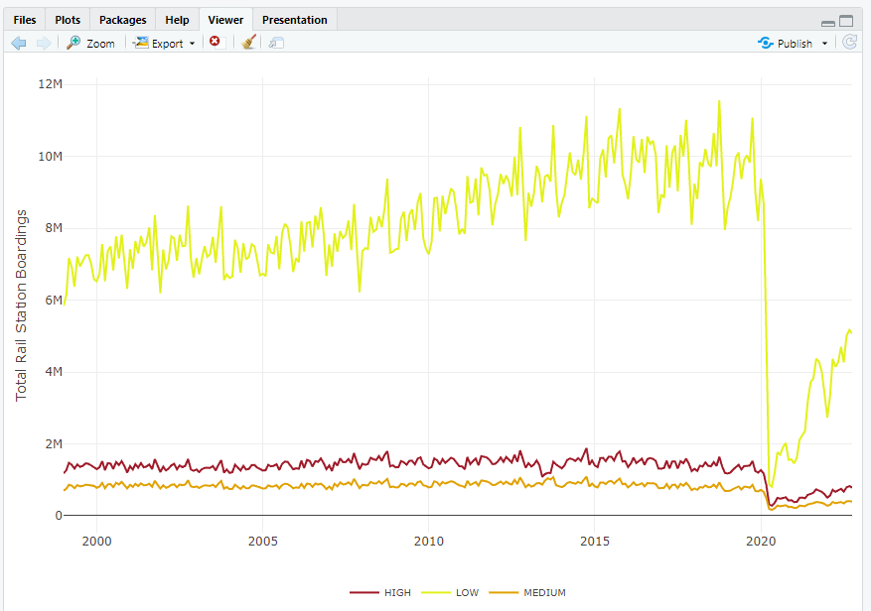
In the space below to copy/paste/insert Figure 5 or 6 from the exercise.
GEO 3330 Sustainable Urban Transportation
Exercise #2: L Station Ridership Trends
How does ridership vary with respect to station CCVI and line?
They stay on trend with risk level. Low risk shows high ridership.

Slide 5
Summarize some potential short- and longer-term implications the pandemic has had on sustainable transportation and public transit ridership?
The world discovered that many jobs can be done online, meaning ridership levels may never recover. Short term is lack of ridership, long term is lack of funding from lack of use.
GEO 3330 Sustainable Urban Transportation
Exercise #2: L Station Ridership Trends
What strategies do you propose to help return transit to pre-pandemic levels?
This is a hard question. Rather than rely on the workforce and the transit system being a utility, we should focus in on convenience, ease of use, and novelty (thinking ‘L’ trains). There isn’t a means to bring workers back to using it when they’re moved online, but we can encourage residents and visitors to utilize the system more than previously to try to bring levels up.

